Slide 1

Stage 4 See Something, Shoot Something Course Designer: Rick Labistre & Ken Wang
See Something, Shoot Something is a 26 round, 130 point, COMSTOCK Long course. There are 10 USPSA targets and 6 steel targets. The best 2 hits per cardboard target will score. Steel must fall to score.
The Handgun start position is standing with hands touching the upper marks. Handgun is loaded and holstered. The PCC start position is standing with PCC loaded, muzzle touching the lower mark, safety on.
On the audible start signal, engage all targets from within the shooting area.

Slide 2
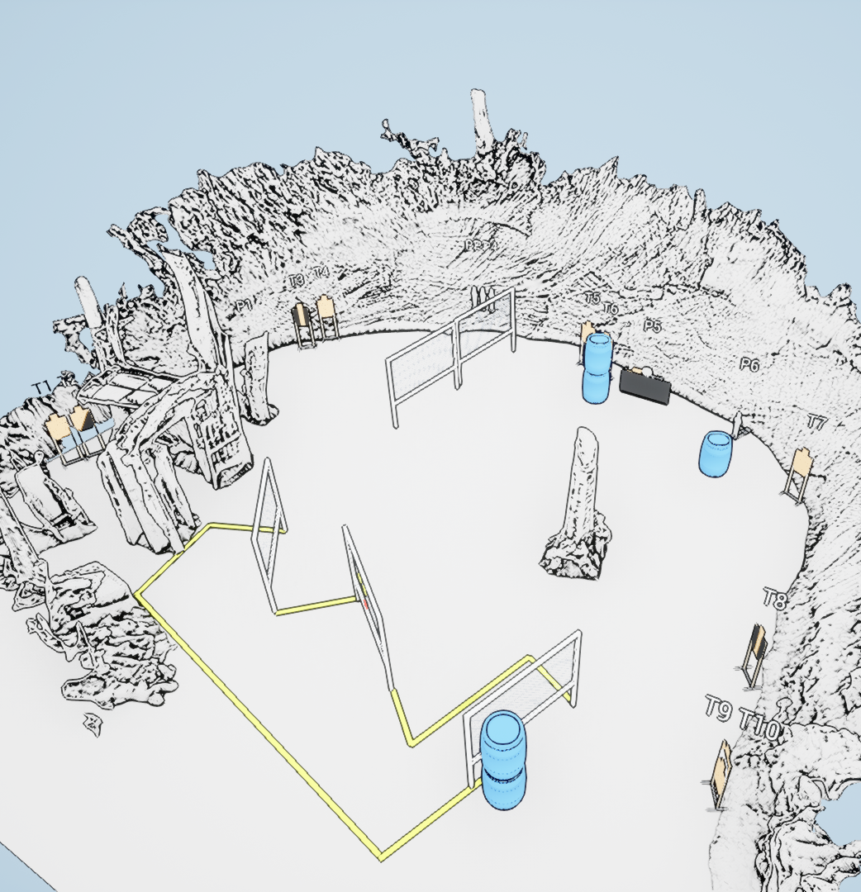
 | Stage 4 See Something, Shoot Something Course Designer: Rick Labistre & Ken Wang

